Slide 1
QUEUEING ANALYSIS

Slide 2
WHY?
Queueing analysis is one of the most important tools for those involved with computer and network analysis.
• What happens to file retrieval time when disk I/O utilization goes up?
• Does response time change if both processor speed and the number of users on the system are doubled?
• How will performance be affected if the process scheduling algorithm includes priorities?
• Which disk scheduling algorithm produces the best average performance?

Slide 3
an organization supports a number of terminals, personal computers, and workstations on a 100-Mbps local area network (LAN). An additional department in the building is to be cut over onto the network. Can the existing LAN handle the increased workload, or would it be better to provide a second LAN with a bridge between the two?

Slide 4
Let’s look at a basic example
Consider a Web server that is capable of handling an individual request in an average of 1 millisecond.
to make things simple, assume that the server handles each request in exactly 1 millisecond.
Now, if the rate of arriving requests is 1 per millisecond (1,000 per second), then it seems sensible to state that the server can keep up with the load.

Slide 5
Let’s look at a realistic example
Let’s look at slightly realistic example.
suppose the average arrival rate for requests is 1 per millisecond but that there is some variability.
During any given 1 millisecond period, there may be no requests, or one, or multiple requests, but the average is still 1 per millisecond.
Solution?
During busy times, when lots of requests bunch up, the server can store outstanding requests in a buffer
Interesting design issue would be: How big should the buffer be?

Slide 6
Assume system can handle 1000 requests per second.
Assume average arrival rate of 500 requests per second.

Slide 7
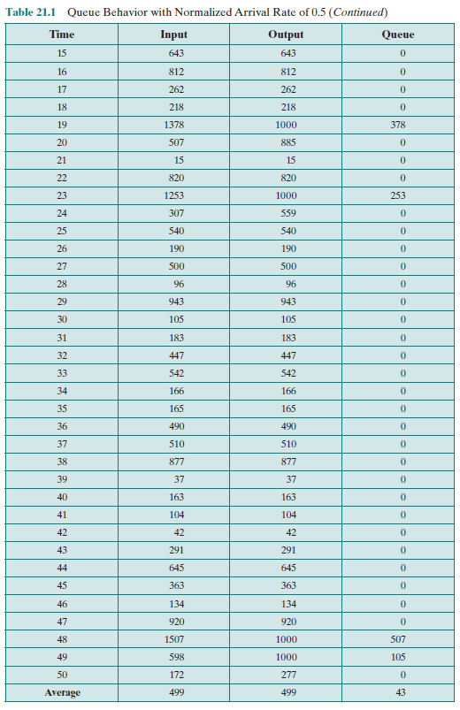
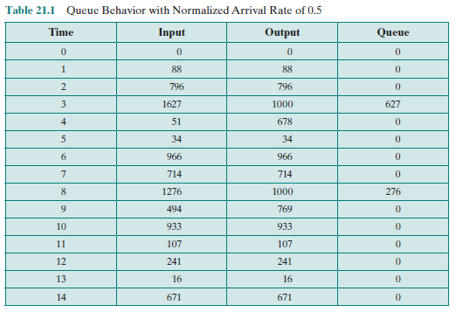

Slide 8
Average buffer content is 43.
Peak over 600 requests.

Slide 9
Now let’s increase the average arrival rate.
Assume average arrival rate of 950 requests per second.

Slide 10
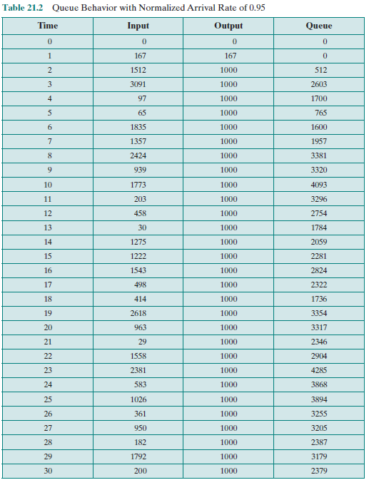
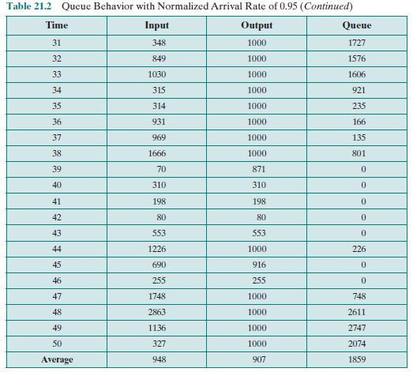

Slide 11
Average buffer content is 1859.
Arrival rate has gone up by less than a factor of 2, but average buffer content has gone up by more than a factor of 40.
Surprising
Behavior of a system queue may not accord with our intuition.

Slide 12
Now let’s increase the average arrival rate again.
Assume average arrival rate of 988 requests per second.
Now the average arrival rate is 99%.

Slide 13
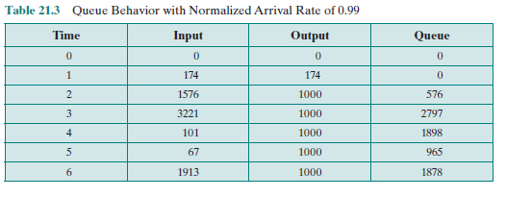
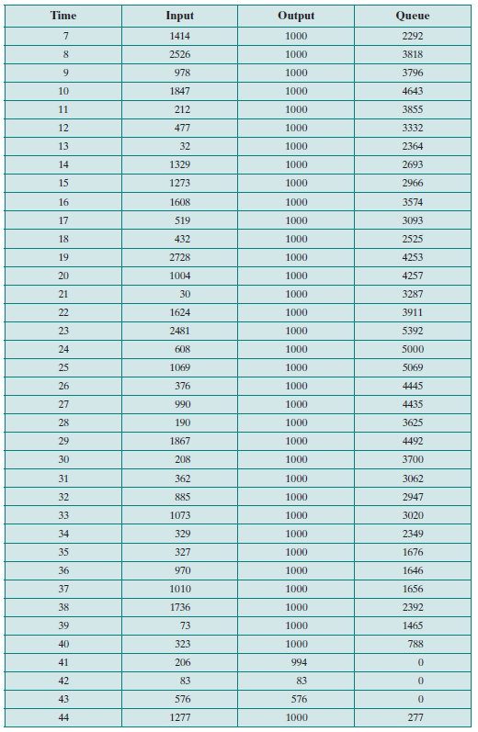
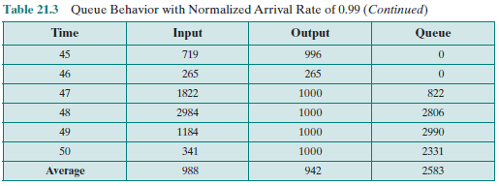

Slide 14
Average buffer content is 2583.
Arrival rate has gone up less than 5% (relative to previous slide)
But average buffer content is increased from 1859 to 2583
~40% increase.

Slide 15
Why Queueing Analysis?
If the system environment changes (like the number of users is doubled), we need to evaluate the resulting system performance
Do an after-the-fact analysis based on actual values.
No option at all.
Make a simple projection (estimation) based on previous experience.
Make a rough estimate (sometimes intuition is incorrect)
Do a queuing analysis.
make use of an analytic model, which is one that can be expressed as a set of equations that can be solved to yield the desired parameters (response time, throughput, etc.).
Program and run a simulation model.

Slide 16
Model characteristics
Item population
We assume items arrive from a source population so large that it can be viewed as infinite.
Queue size
Assume queue size to be infinite
Dispatching discipline
When the server becomes free, and if there is more than one item waiting, a decision must be made as to which item to dispatch next.
FIFO
LIFO
QoS (quality of service—e.g., in routers)
Service time (very difficult to model analytically)

Slide 17
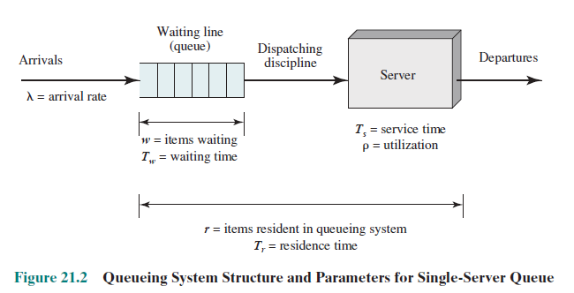
Basic concepts in Queueing analysis

Slide 18
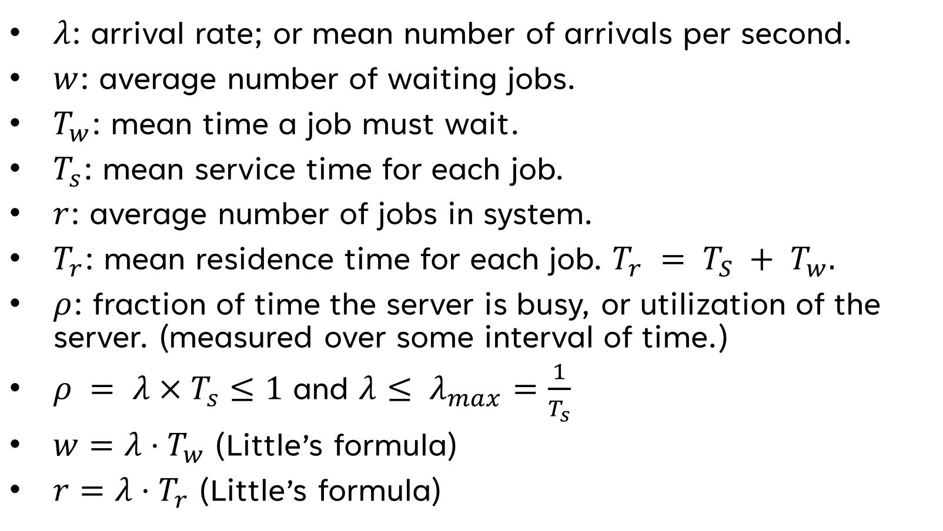
Basic concepts
$λ$: arrival rate; or mean number of arrivals per second.
$w$: average number of waiting jobs.
$T_{w}$: mean time a job must wait.
$T_{s}$: mean service time for each job.
$r$: average number of jobs in system.
$T_{r}$: mean residence time for each job. $T_{r} = T_{S} + T_{w}.$
$ρ$: fraction of time the server is busy, or utilization of the server. (measured over some interval of time.)
$ρ = λ×T_{s}≤1$ and $λ≤ λ_{max}⁡=\frac{1}{T_{s}}$
$w=λ⋅T_{w}$ (Little’s formula)
$r=λ⋅T_{r}$ (Little’s formula)

Slide 19
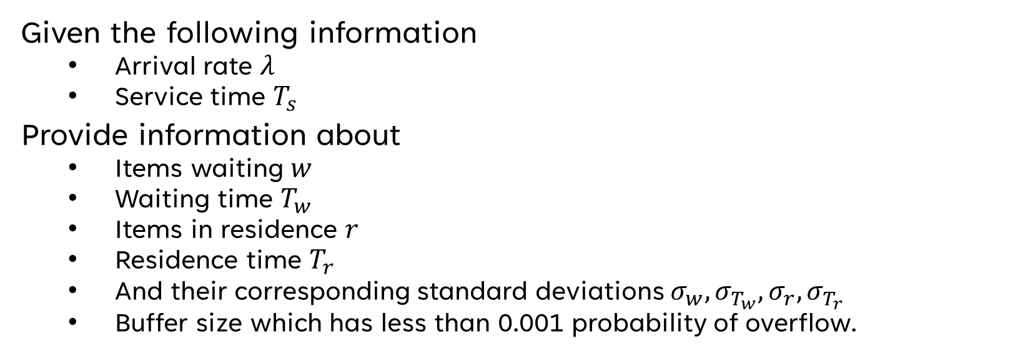
Goal in queueing analysis
Given the following information
Arrival rate $λ$
Service time $T_{s}$
Provide information about
Items waiting $w$
Waiting time $T_{w}$
Items in residence $r$
Residence time $T_{r}$
And their corresponding standard deviations $σ_{w}, σ_{T_{w}}, σ_{r}, σ_{T_{r}}$
Buffer size which has less than 0.001 probability of overflow.

Slide 20
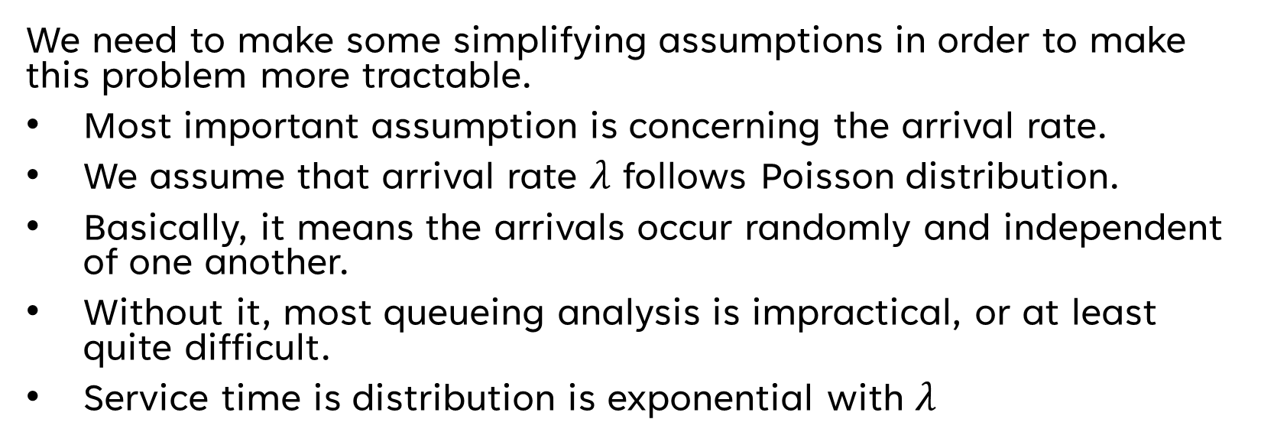
Assumptions
We need to make some simplifying assumptions in order to make this problem more tractable.
Most important assumption is concerning the arrival rate.
We assume that arrival rate $λ$ follows Poisson distribution.
Basically, it means the arrivals occur randomly and independent of one another.
Without it, most queueing analysis is impractical, or at least quite difficult.
Service time is distribution is exponential with $λ$

Slide 21
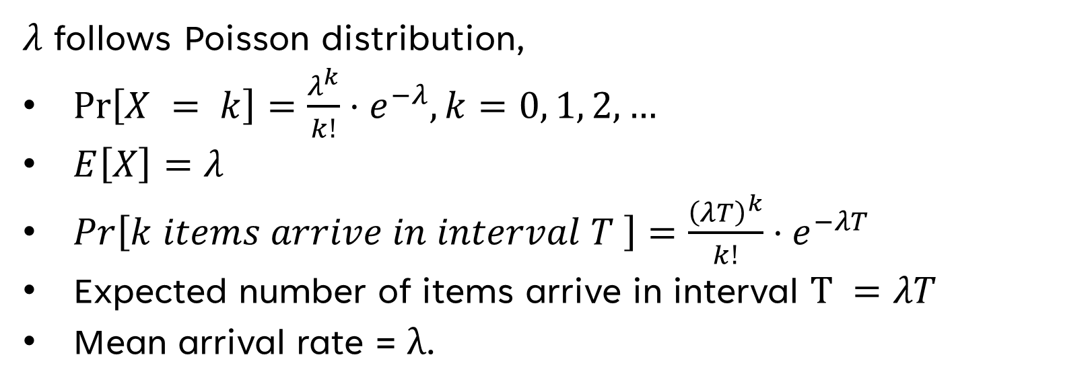
Assumptions
$λ$ follows Poisson distribution,
$\operatorname{Pr}\left[X = k\right]=\frac{λ^{k}}{k!}⋅e^{−λ}, k=0, 1, 2, …$
$E\left[X\right]=λ$
$Pr\left[k items arrive in interval T \right]=\frac{{\left(λT\right)}^{k}}{k!}⋅e^{−λT}$
Expected number of items arrive in interval $T =λT$
Mean arrival rate = λ.

Slide 22

Assumptions cont..
Service time distribution is exponential with $λ.$
$P\left[X≤x\right]=1 −e^{−λx}.$
$E\left[x\right]=σ_{X}=\frac{1}{λ}$.

Slide 23

$$r=\frac{ρ}{1−ρ}$$
$$w=\frac{ρ^{2}}{1−ρ}$$
$$T_{r}=\frac{T_{s}}{1−ρ}$$
$$T_{w}=\frac{ρT_{s}}{1−ρ}$$
$$σ_{r}=\frac{\sqrt{ρ}}{1−ρ}$$
$$σ_{T_{r}}=\frac{T_{s}}{1−ρ}$$
$m_{T_{r}}\left(y\right)=T_{r}×\ln\left(\frac{100}{100−y}\right)$ the value $T_{r}$ occurs $y$ percent of time.
$$m_{x}\left(y\right) means \text{the} \text{yth} \text{percentile} \text{that} \text{value} \text{of} \text{y} \text{below} \text{such} \text{that} \text{x} \text{occurs} \text{y} \text{percent} \text{of} \text{the} \text{time}$$

Slide 24
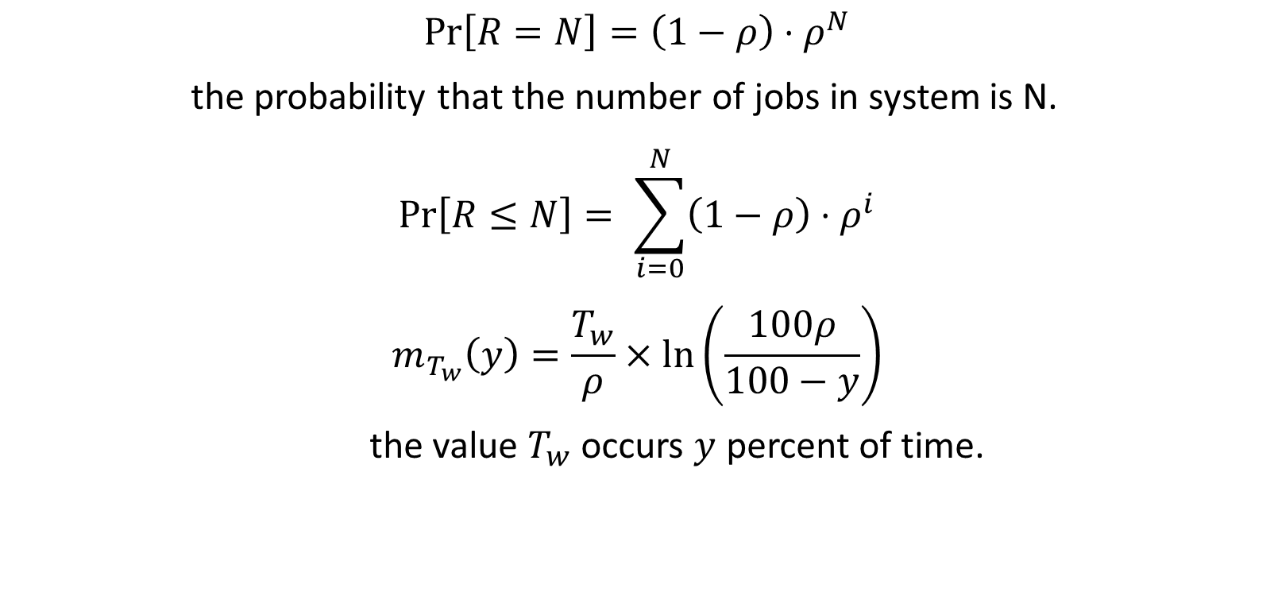
$$\operatorname{Pr}\left[R=N\right]=\left(1−ρ\right)⋅ρ^{N}$$
the probability that the number of jobs in system is N.
$$\operatorname{Pr}\left[R≤N\right]= \sum_{i=0}^{N}{\left(1−ρ\right)⋅ρ^{i}}$$
$$m_{T_{w}}\left(y\right)=\frac{T_{w}}{ρ}×\ln\left(\frac{100ρ}{100−y}\right)$$
the value $T_{w}$ occurs $y$ percent of time.

Slide 25
Examples
Consider a LAN with 100 personal computers and a server that maintains a common database for a query application. The average time for the server to respond to a query is 0.6 seconds, and the standard deviation is estimated to equal the mean. At peak times, the query rate over the LAN reaches 20 queries per minute. We would like to answer the following questions:
What is the average response time ignoring line overhead?
If a 1.5-second response time is considered the maximum acceptable, what percent growth in message load can occur before the maximum is reached?
If +20% more utilization is experienced, will response time increase by more or less than 20%?

Slide 26
As worded, there is no answer for (2) because there is a nonzero probability that some instances of response time will exceed 1.5 seconds for any value of utilization
Let’s rephrase: Instead, let us say we would like 90% of all responses to be less than 1.5 seconds. Then what percent growth in message load can occur while keeping the response time under 1.5s 90% of the time.

Slide 27
Ex 2: Consider a configuration in which packets are sent from computers on a LAN to systems on other networks. All these packets must pass through a router that connects the LAN to a wide area network and hence to the outside world. Packets arrive with a mean arrival rate of 5 per second. The average packet length is 144 bytes, and it is assumed to be exponentially distributed. Line speed from the router to the Internet is 9600bps.
What is the mean residence time in the router?
What is the average number of packets in the router?
What is the upper bound of the number of packets in the router, for 90% of the time?

